Slide 1

15EC502 – Linear Integrated Circuits

Slide 2
UNIT IV - ANALOG TO DIGITAL AND DIGITAL TO ANALOG CONVERTERS
Analog and Digital Data Conversions
Specifications
D/A Converter
Weighted Resistor type
R–2R Ladder type
Voltage Mode and Current Mode
High Speed Sample–and–Hold Circuits
A/D Converters
Flash Type
Successive Approximation Type
Single Slope Type
Dual Slope Type.

Slide 3
ADC and DAC Converters

Slide 4
ADC and DAC
DAC:
Weighted Resistor DAC
R-2R Ladder DAC
Inverted R-2R DAC
ADC:
DIRECT TYPE:
The Parallel Comparator (Flash) ADC
The Counter type ADC
Servo Tracking ADC
Successive Approximation Converter
INTEGRATING TYPE:
Charge Balancing ADC
Single Slope ADC
Dual-Slope ADC

Slide 5
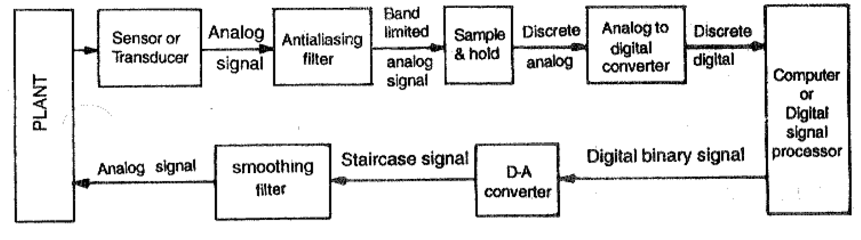
ADC and DAC
Introduction:

Slide 6
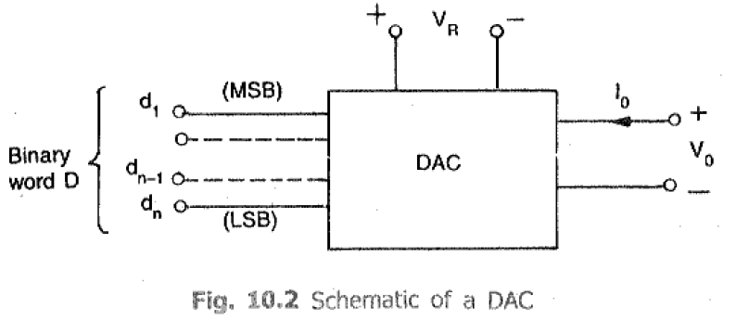
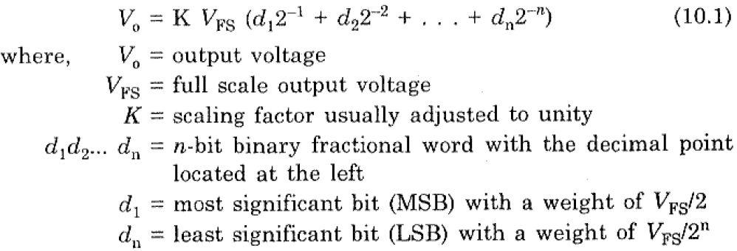
ADC and DAC
Introduction - BASICs:

Slide 7
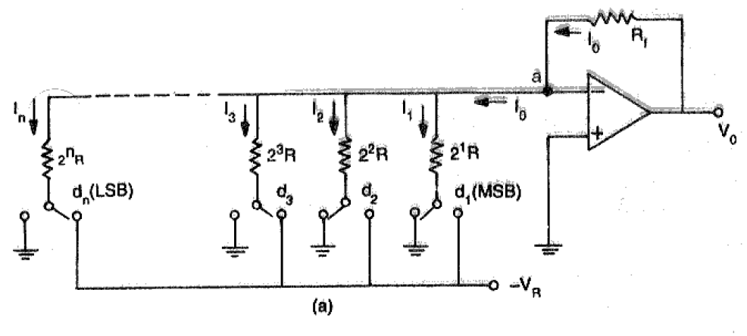
DAC
Weighted Resistor DAC

Slide 8
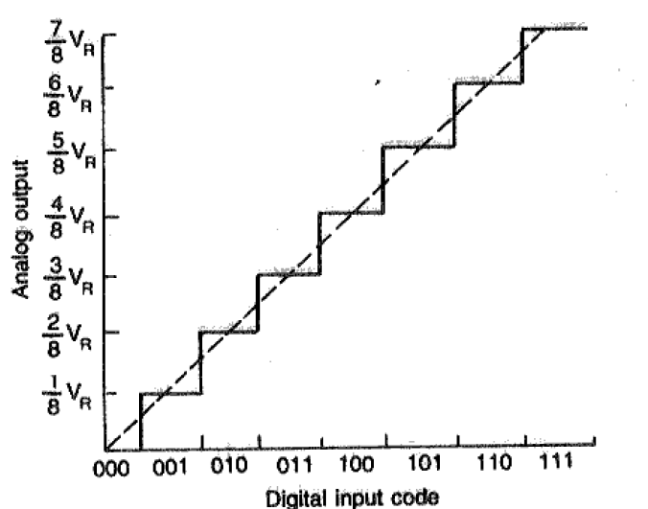
DAC
Weighted Resistor DAC

Slide 9
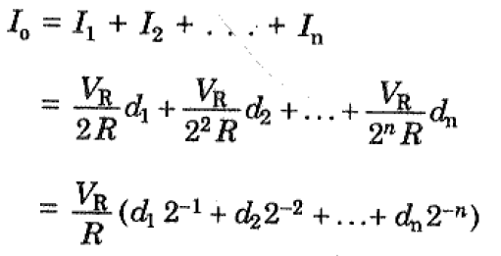


DAC
Weighted Resistor DAC

Slide 10
DAC
Weighted Resistor DAC
Advantages:
It is Simple in Construction.
It provides fast conversion.
Disadvantages:
This type requires large range of resistors with necessary high precision for low resistors.
Requires low switch resistances in transistors.
Can be expensive. Hence resolution is limited to 8-bit size.

Slide 11
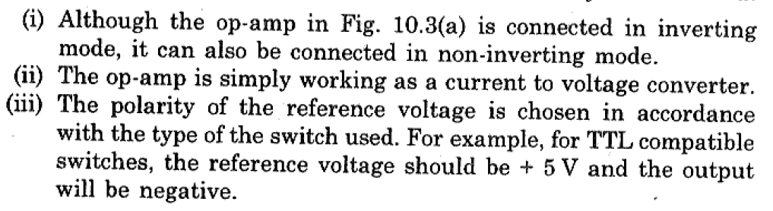
DAC
Weighted Resistor DAC

Slide 12
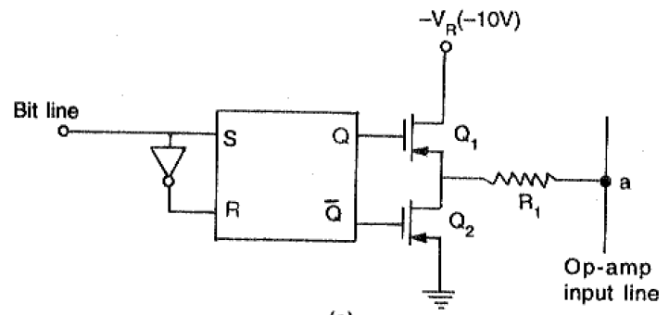
DAC
DAC Switches – A Totem Pole MOSFET Switch

Slide 13
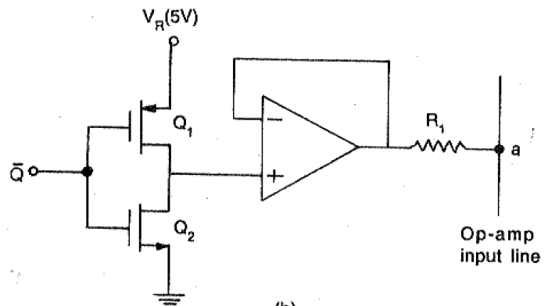
DAC
DAC Switches – CMOS Inverter as a Switch

Slide 14
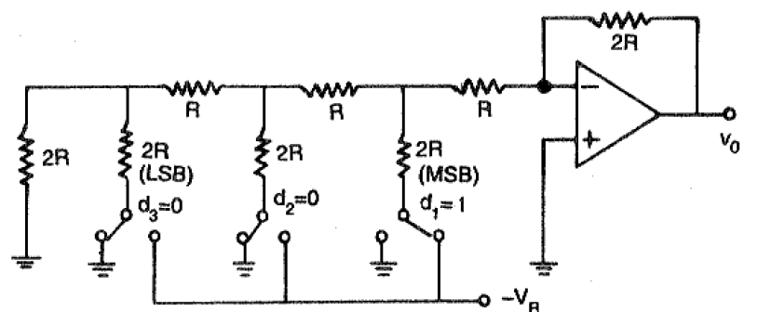
DAC
R-2R Ladder DAC

Slide 15
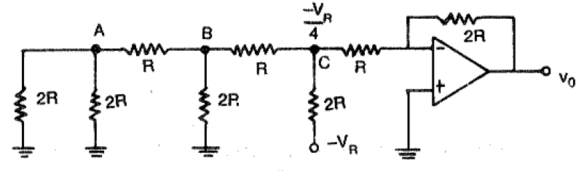
DAC
R-2R Ladder DAC
If Binary word d₁d₂d₃ = 100 is applied, then

Slide 16
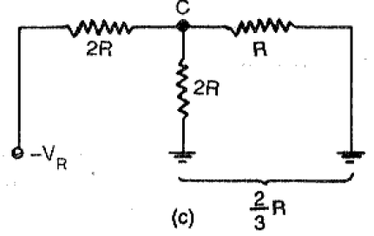

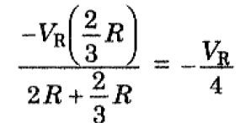
DAC
R-2R Ladder DAC
Apply nodal equation at point C, then
V_{c}/R +V_{c}/2R + (V_{c}+V_{R})/2R = 0
Solving for V_{c}, then
V_{c} = -V_{R}/4
The Output Voltage of Inverting Amplifier is,

Slide 17
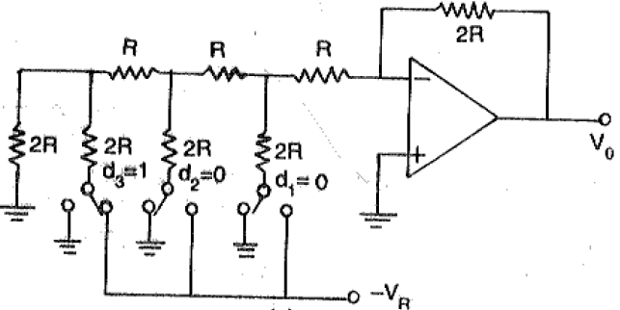
DAC
R-2R Ladder DAC
If Binary word d₁d₂d₃ = 001 is applied, then

Slide 18
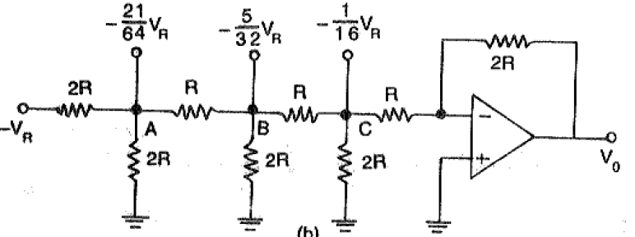

DAC
R-2R Ladder DAC

Slide 19
DAC
R-2R Ladder DAC
Advantages:
Only two resistor values are used in R-2R ladder type.
It does not need as precision resistors as Binary weighted DACs.
It is cheap and easy to manufacture.
Disadvantages:
It has slower conversion rate.

Slide 20
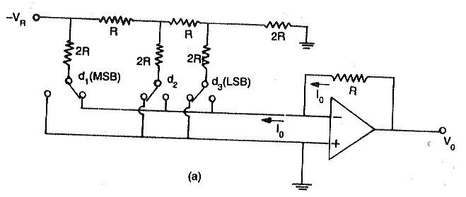
DAC
Inverted R-2R Ladder DAC

Slide 21
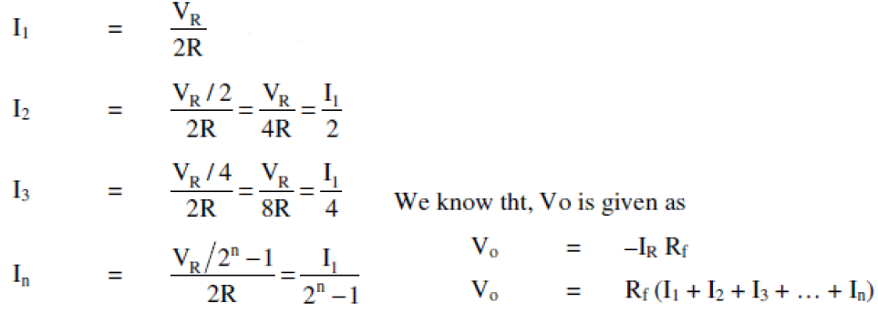
DAC
Inverted R-2R Ladder DAC
Here, each bit of the binary word connects the corresponding switch either to ground or to the inverting input terminal of the op-amp which is at the virtual ground.
Since both the positions of switches are at ground potential, the current flowing through resistances is constant and it is independent of switch position.

Slide 22
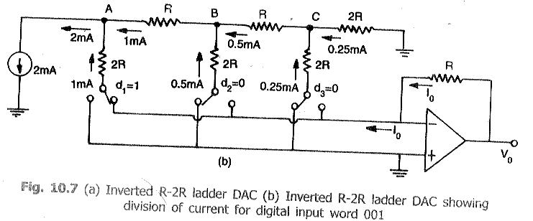
DAC
Inverted R-2R Ladder DAC

Slide 23
DAC
Inverted R-2R Ladder DAC
Advantages
The major advantage of current mode D/A converter is that the voltage change across each switch is minimal. So the charge injection is virtually eliminated and the switch driver design is made simpler.
2. In Current mode or inverted ladder type DACs, the stray capacitance do not affect the speed of response of the circuit due to constant ladder node voltages. So improved speed performance

Slide 24

DAC
Problems

Slide 25
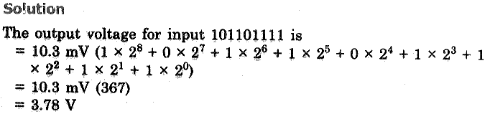
DAC
Problems

Slide 26
DAC
Problems
Calculate the values of LSB, MSB and FS output for an 8-bit DAC for the 0 to 10V range.

Slide 27
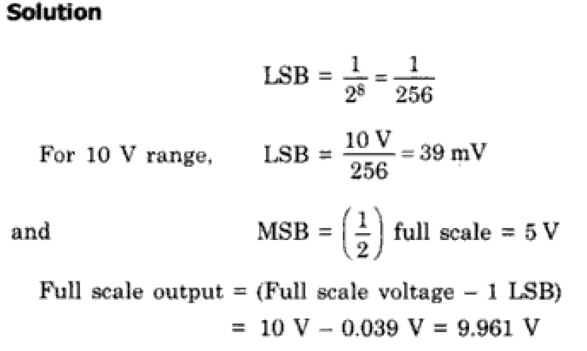
DAC
Problems

Slide 28
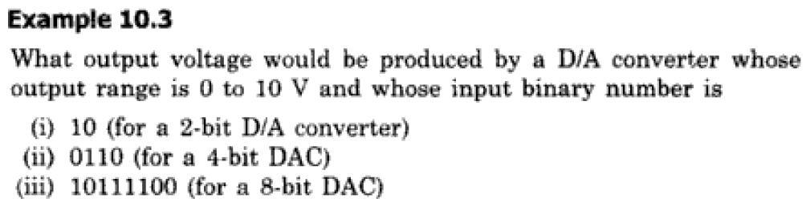
DAC
Problems

Slide 29
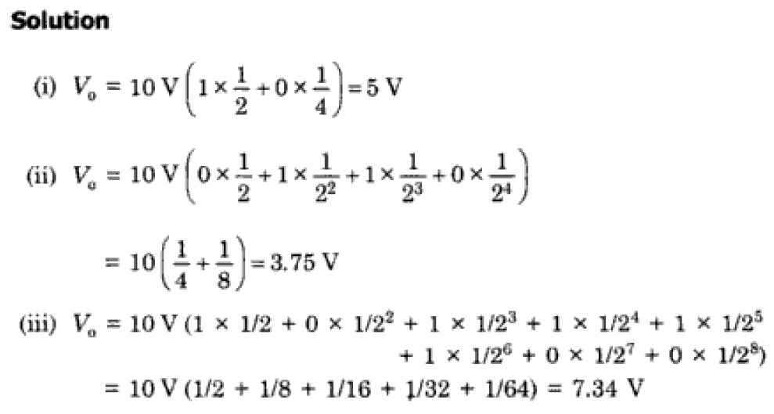
DAC
Problems

Slide 30
ANALOG TO DIGITAL CONVERTER (ADC)
ADC:
It has two additional signals,
Start
EOC (End of Conversion)
Two types,
Direct type
Indirect or Integrating type
DIRECT TYPE:
The Parallel Comparator (Flash) ADC
The Counter type ADC
Servo Tracking ADC
Successive Approximation Converter
INTEGRATING TYPE:
Charge Balancing ADC
Single Slope ADC
Dual-Slope ADC

Slide 31
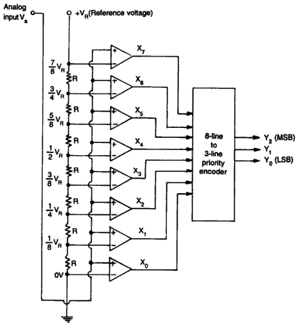
ANALOG TO DIGITAL CONVERTER (ADC)
1. Parallel Comparator (Flash) ADC

Slide 32

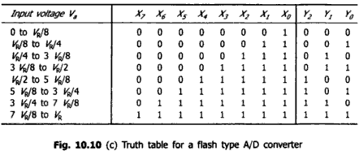
ANALOG TO DIGITAL CONVERTER (ADC)
1. Parallel Comparator (Flash) ADC

Slide 33
ANALOG TO DIGITAL CONVERTER (ADC)
1. Parallel Comparator (Flash) ADC
The working of a 3-bit flash type ADC is as follows.
The voltage divider network contains 8 equal resistors. A reference voltage V_{R} is applied across that entire network with respect to the ground. The voltage drop across each resistor from bottom to top with respect to ground will be the integer multiples (from 1 to 8) of V_{R}/8
The external input voltage Va is applied to the non-inverting terminal of all comparators. The voltage drop across each resistor from bottom to top with respect to ground is applied to the inverting terminal of comparators from bottom to top.
At a time, all the comparators compare the external input voltage with the voltage drops present at the respective other input terminal. That means, the comparison operations take place by each comparator parallel.
The output of the comparator will be ‘1’ as long as Va is greater than the voltage drop present at the respective other input terminal. Similarly, the output of comparator will be ‘0’, when, Va is less than or equal to the voltage drop present at the respective other input terminal.
All the outputs of comparators are connected as the inputs of priority encoder. This priority encoder produces a binary code (digital output), which is corresponding to the high priority input that has ‘1’.
Therefore, the output of priority encoder is nothing but the binary equivalent (digital output) of external analog input voltage, Va.

Slide 34
ANALOG TO DIGITAL CONVERTER (ADC)
1. Parallel Comparator (Flash) ADC
Advantages:
High Speed Parallel Conversion (~100ns)
The construction is simple and easier to design.
Disadvantages:
The number of Comparators doubles for every added bit
(for n-bit output, (2n – 1) comparators are required)
Larger Area and Cost
It is not suitable for higher number of bits.

Slide 35
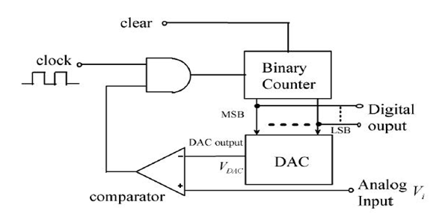
ANALOG TO DIGITAL CONVERTER (ADC)
2. Counter Type ADC

Slide 36
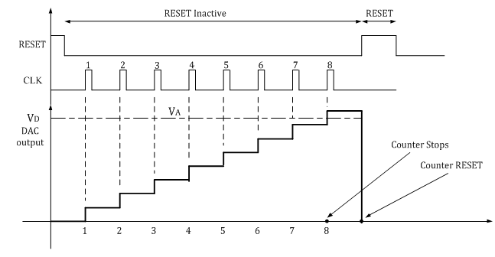
ANALOG TO DIGITAL CONVERTER (ADC)
2. Counter Type ADC

Slide 37
ANALOG TO DIGITAL CONVERTER (ADC)
2. Counter Type ADC
Drawback :
Low speed is the most serious drawback of this method.
The conversion time can be as (2^{n}−1) clock periods depending upon the magnitude of input voltage VI. For instance, a 12-bit system with 1MHz clock frequency, the counter will take (2¹²−1)µs= 4.095ms to convert a full scale input.

Slide 38
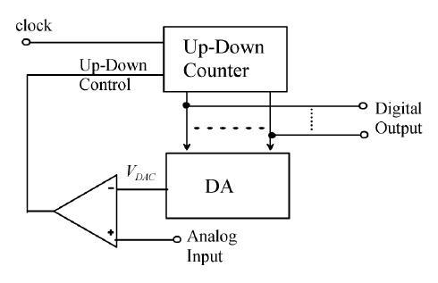
ANALOG TO DIGITAL CONVERTER (ADC)
3. Servo Tracking ADC

Slide 39
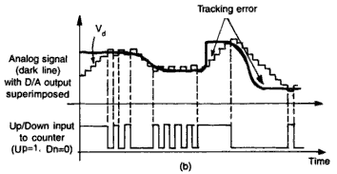
ANALOG TO DIGITAL CONVERTER (ADC)
3. Servo Tracking ADC

Slide 40
ANALOG TO DIGITAL CONVERTER (ADC)
3. Servo Tracking ADC
Advantages of Tracking type ADC
Shift register is not needed so the cost is less.
Speed is high compared to digital ramp type as the counter will not reset
Disadvantages of Tracking type ADC
Up/Down counter leads to complexity of the circuit.
The digital output will never be constant because of differentiator effect. i.e. for a constant analog value also the output will oscillating this is known as bit bobble.

Slide 41
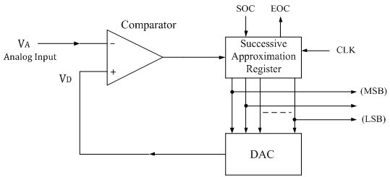
ANALOG TO DIGITAL CONVERTER (ADC)
4. Successive Approximation ADC

Slide 42
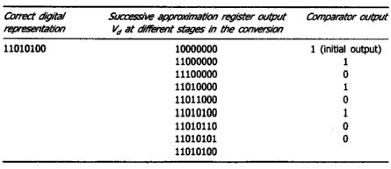
ANALOG TO DIGITAL CONVERTER (ADC)
4. Successive Approximation ADC

Slide 43
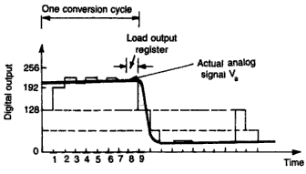
ANALOG TO DIGITAL CONVERTER (ADC)
4. Successive Approximation ADC

Slide 44
ANALOG TO DIGITAL CONVERTER (ADC)
4. Successive Approximation ADC
Advantages:
Conversion time is very small.
Conversion time is constant and independent of the amplitude of the analog input signal V_{A}.
Disadvantages:
Circuit is complex.
The conversion time is more compared to flash type ADC.

Slide 45
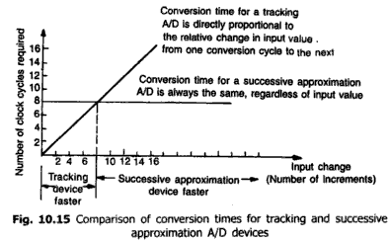
ANALOG TO DIGITAL CONVERTER (ADC)
ADC Comparisons

Slide 46
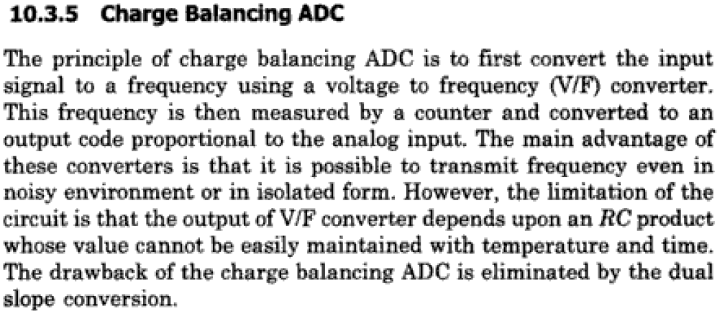
ANALOG TO DIGITAL CONVERTER (ADC)
1. Charge Balancing ADC

Slide 47
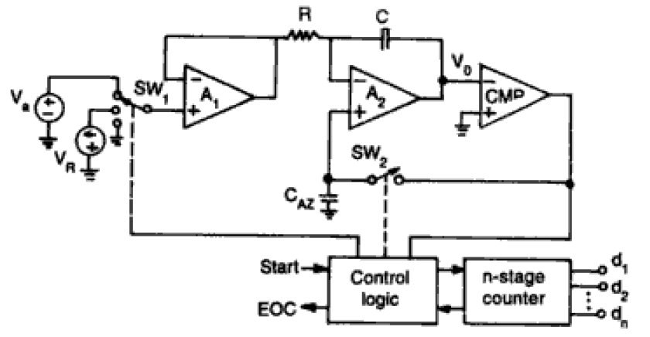
ANALOG TO DIGITAL CONVERTER (ADC)
2. Dual Slope ADC

Slide 48
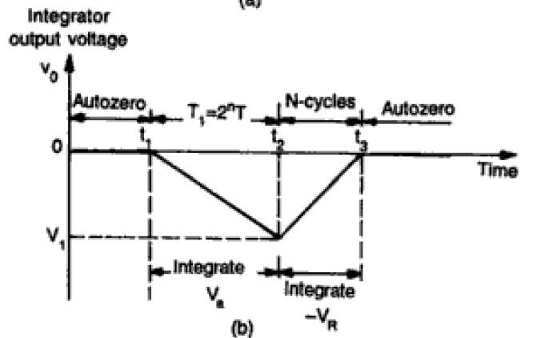
ANALOG TO DIGITAL CONVERTER (ADC)
2. Dual Slope ADC

Slide 49
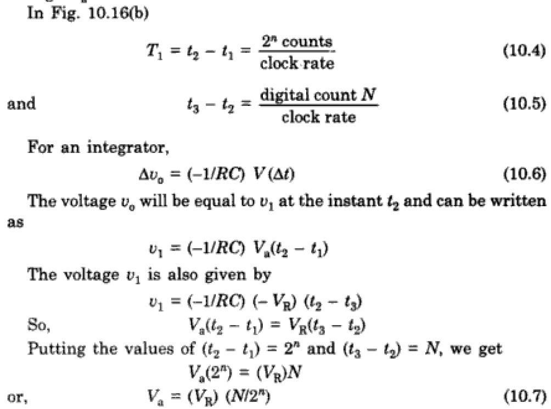
ANALOG TO DIGITAL CONVERTER (ADC)
2. Dual Slope ADC

Slide 50
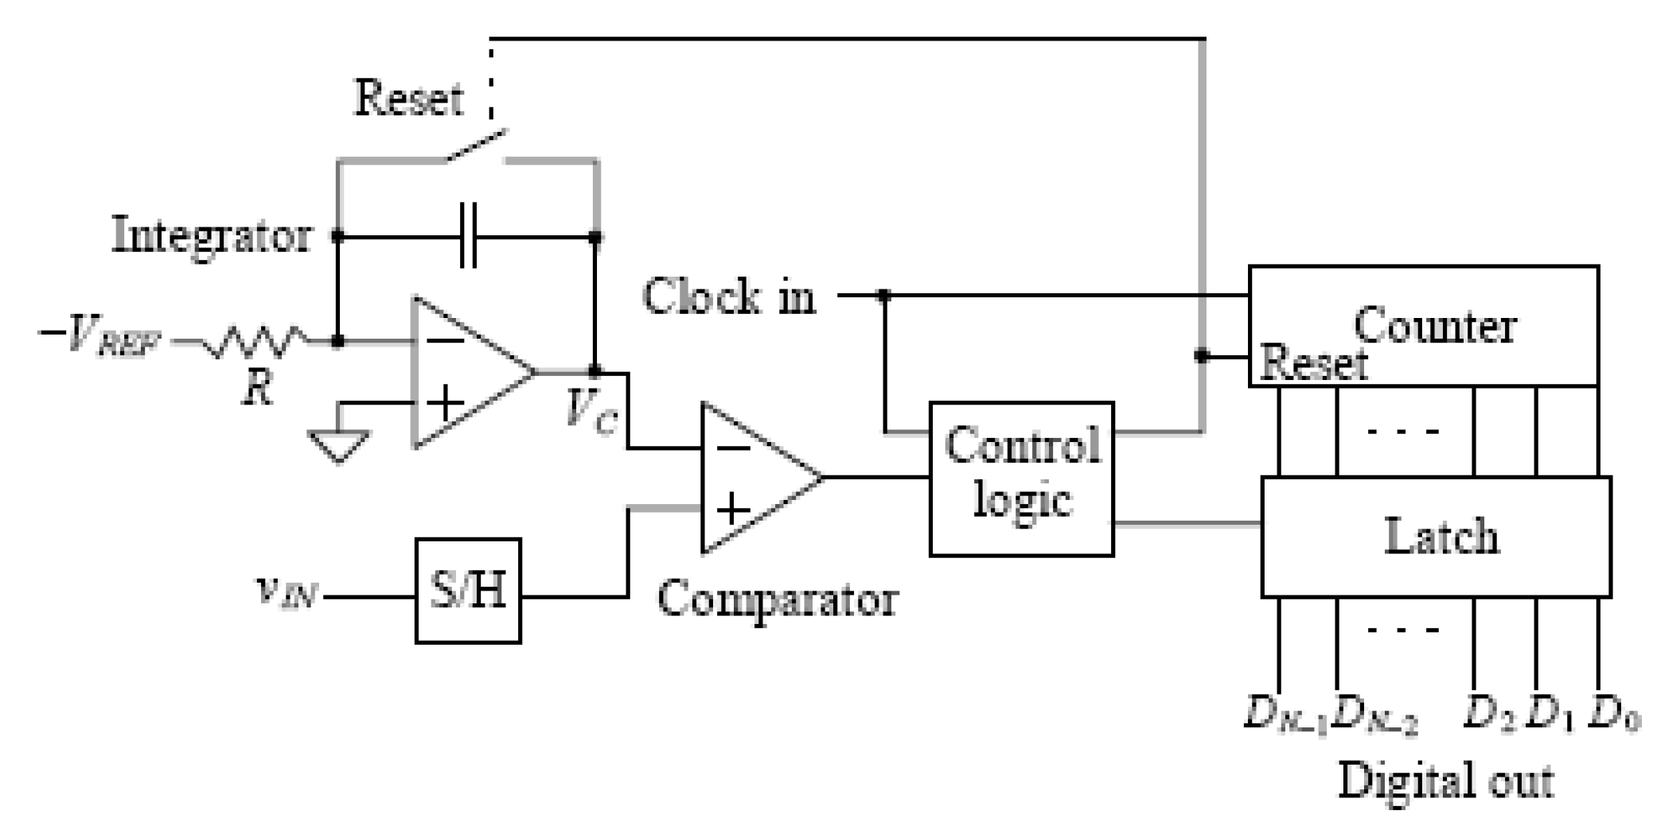
ANALOG TO DIGITAL CONVERTER (ADC)
3. Single Slope ADC

Slide 51
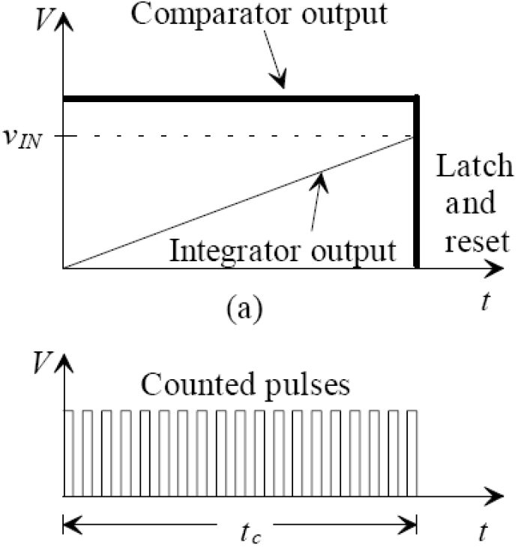
ANALOG TO DIGITAL CONVERTER (ADC)
3. Single Slope ADC

Slide 52
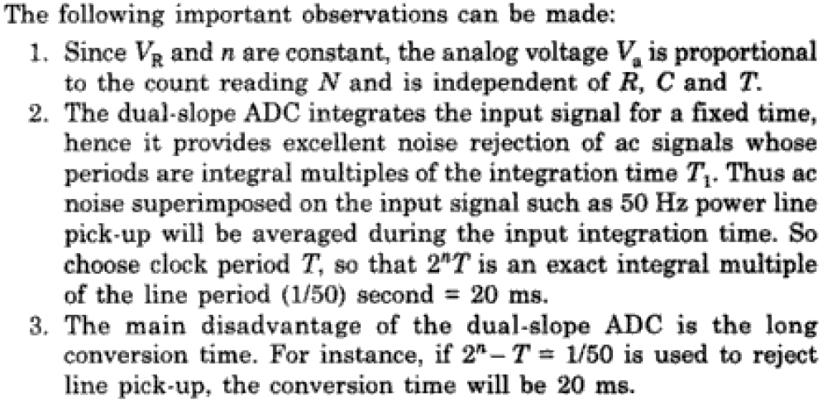
ANALOG TO DIGITAL CONVERTER (ADC)
3. Dual Slope ADC

Slide 53
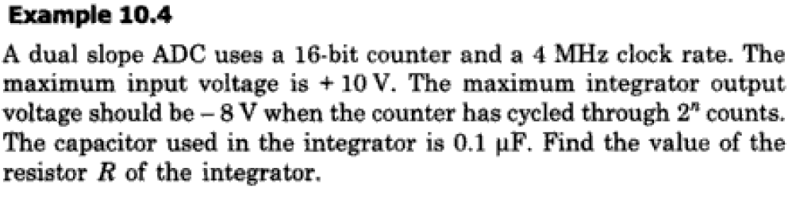
ANALOG TO DIGITAL CONVERTER (ADC)
Problems

Slide 54
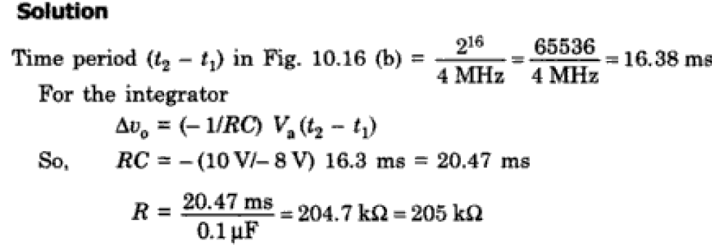
ANALOG TO DIGITAL CONVERTER (ADC)
Problems

Slide 55
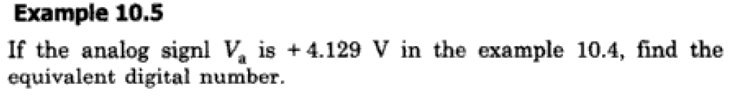
ANALOG TO DIGITAL CONVERTER (ADC)
Problems

Slide 56
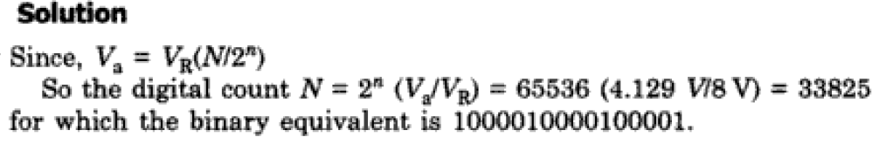
ANALOG TO DIGITAL CONVERTER (ADC)
Problems

Slide 57
ADC and DAC
Specifications
Resolution
The resolution of a DAC is the smallest change in the output of the DAC for any change in digital input. i.e. if a input to DAC changes one bit, how much analog output has changed in full scale deflection.
% Resolution = [Step size / Full scale output (FSO)] * 100
Accuracy
The Accuracy of a DAC is the difference between output practical analog output to the ideal expected output for a given digital input. T
Absolute Accuracy: Maximum deviation between actual converter output and the ideal converter output.
Relative Accuracy: Maximum deviation between actual converter output and the ideal converter output. after Gain and offset errors have been removed
The another factor which implicates the accuracy is the zero offset error i.e for a zero input the output of DAC reflects some offset value.

Slide 58
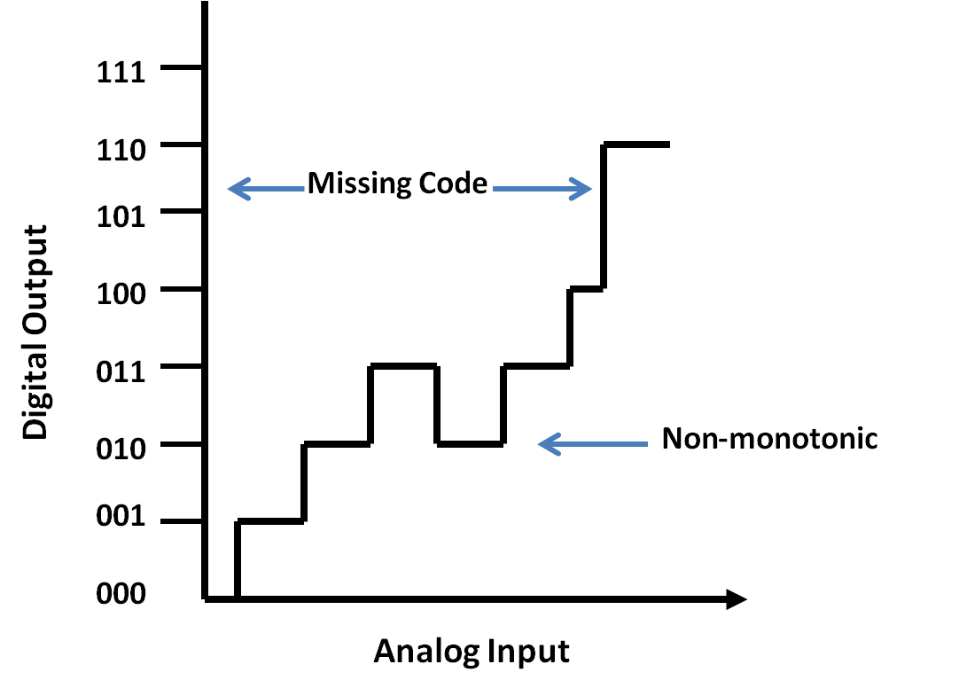
ADC and DAC
Specifications
Conversion Speed/Settling Time
The conversion speed of the DAC is output analog value settling time period for a change in the digital input. This is also called settling time period of DAC. Normally it will be micro seconds and in some advanced micro controller DAC it may be nano seconds.
Monotonicity
The Digital to Analog Converter is said to be monotonic if its analog value is either increasing or equal to previous value for an LSB change in input digital signal.

Slide 59
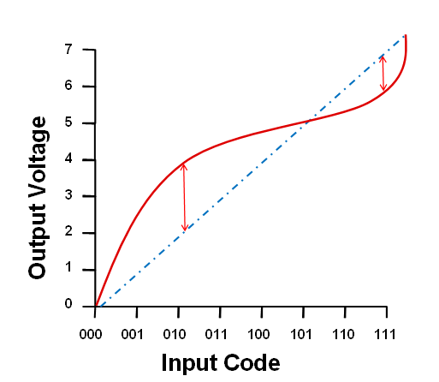
ADC and DAC
Specifications
Linearity
In ADC or DAC linearity refers to, how close the converter output is to the ideal transfer characteristics.
In DAC, increment in digital input should produce equal increment in the analog output and the Transfer curve should be linear.
Referred as INL (Integral Non-Linearity) and or DNL (Differential Non-Linearity)
Stability
The performance of the converter due to aging, temperature, power supply and environmental changes.
DNL for each step = Actual Step width - Pefact Step width To avoid the missing code, the DNL for any ADC should be less than ± 1LSB.
INL: INL or integral non-linearity is the integral of all the DNLs in the transfer function. It shows how the actual transfer curve deviates from the perfect transfer curve.

Slide 60
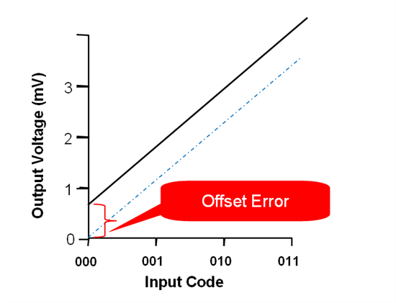
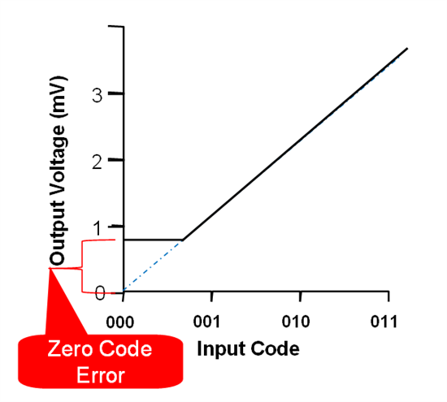
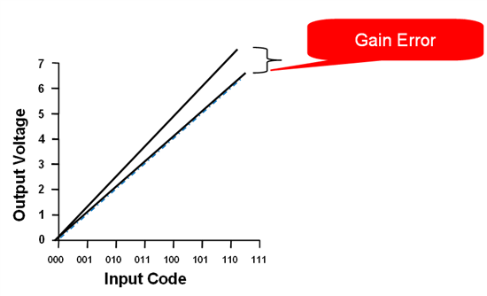
ADC and DAC
Specifications

Slide 61
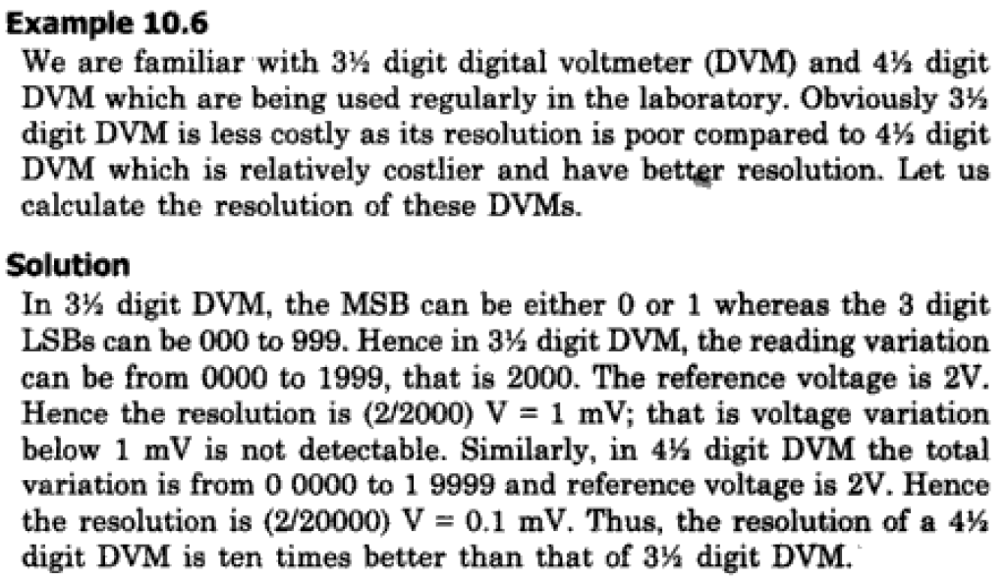
Resolution: Problem

Slide 62
https://www.electronics-tutorial.net/analog-integrated-circuits/data-converters/flash-type-adc/
https://www.electronics-tutorial.net/analog-integrated-circuits/data-converters/r-2r-ladder-dac/
https://he-coep.vlabs.ac.in/Experiment6/Theory.html?domain=ElectronicsandCommunications&lab=Hybrid%20Electronics%20Lab

